Slide 1
Project Thermique
An Integrated AI-based Temperature Sensing & Management System to Hold Back COVID-19 contamination

Slide 2
Members of Foxtrot_B
201814023 - Ishraq Hasan
201814044 - Kazi Tasnim Rahman
201814021 - Md Rokonuzzaman Reza
201814052 - Muhammad Munswarim Khan
201814057 - Tashfia Fatema
201814059 - Shaqran Bin Saleh

Slide 3
Project Proposal
Motivation:
The Covid-19 pandemic spread
How it infects more people in a crowded area
How offices/institutes can be a risk factor
Goal:
To restrict the spread of Covid-19 from an infected person to the masses
Implement a filtering system based on body temperature scanning
Scanning process needs to be contactless, to avoid contamination
Use RFID as an identification mechanism

Slide 4
Project Scheduling
Project was planned in a structured manner
Microsoft Project was used to plan the schedule and resources
Hardware revisions were added after completion of each revision
On-site visits to the deployment site were crucial for the development
Brief summary of each part of the project’s timeline:
Project Initialization [02 July 2020 ~ 14 Aug 2020] 32 days
Implementation of Rev1 [24 July 2020 ~ 17 Aug 2020] 40 days
Field work/Campus visit [13 Aug 2020 ~ 15 Sep 2020] 3 days
Implementation of Rev2 [18 Sep 2020 ~ 30 Nov 2020] 52 days
{Rev3 not scheduled yet}

Slide 5
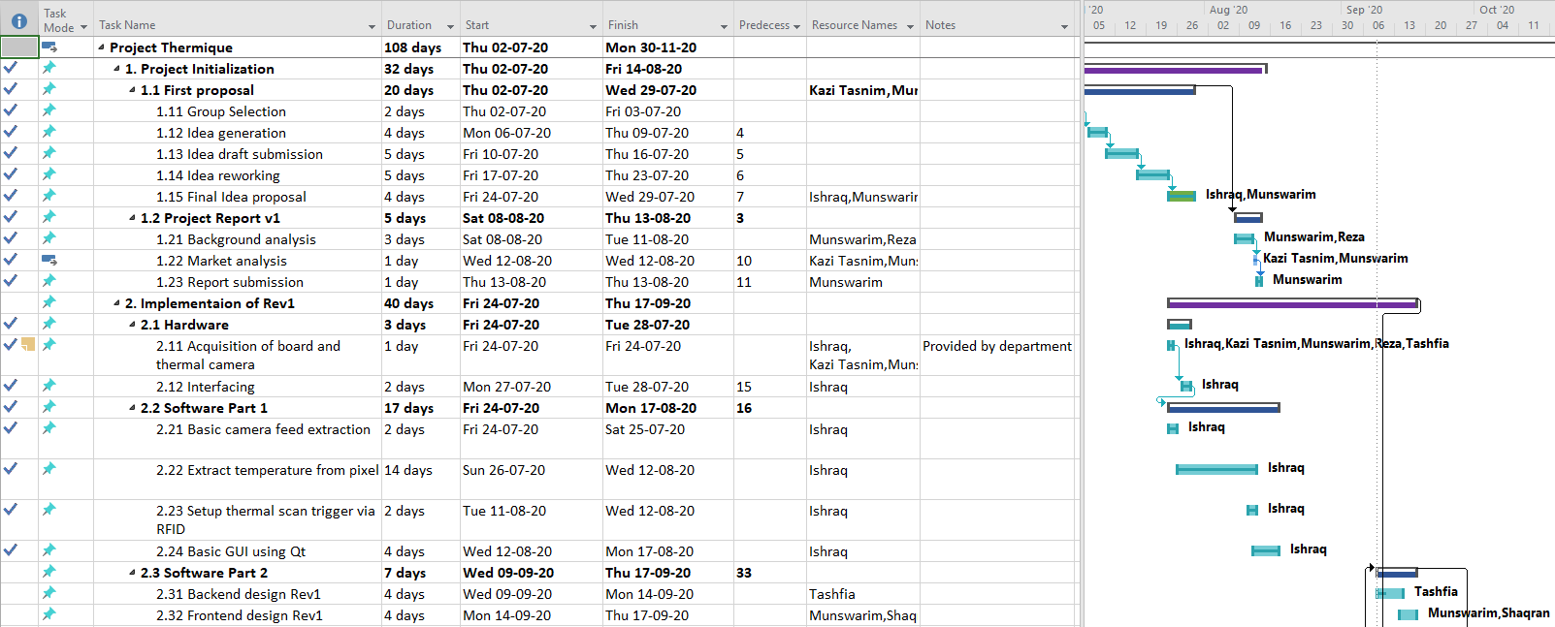
MS Project Plan [part 1 of 2]

Slide 6
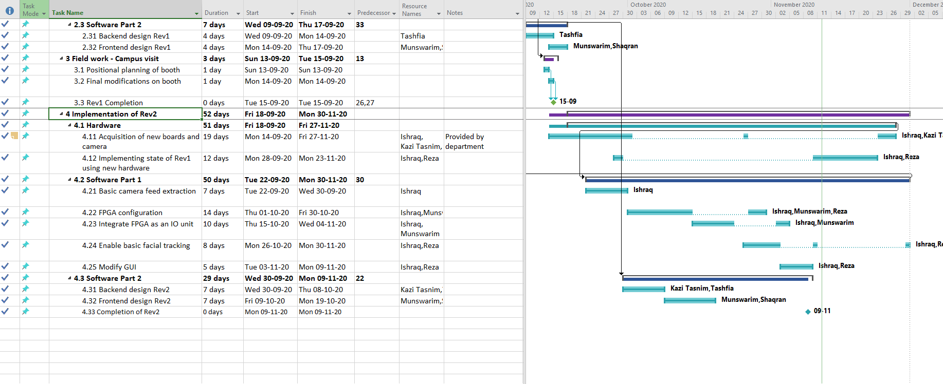
MS Project Plan [part 2 of 2]

Slide 7
Software Requirements Specification

Slide 8
User Requirements
Detection off exact body temperature upon scanning and displaying it on the monitor
Storing every individual’s temperature in a database and updating in real time
Identification of individual’s face and marking the location of face within the camera feed
Send an immediate notification to authority when someone is detected with high temperature
Comfortable positioning of the RFID scanner
Responsive database and camera feed website
Fast responsive scanner so that two users can scan within a time difference of five seconds

Slide 9
System Requirements Specification
Detection and display of the exact body temperature:
Lepton module
Storing individual’s temperature in a database:
Database system
Identifying the position of individual’s face:
Artificial intelligence
Notifying the authority while identifying a high temperature in someone:
Setting up a notification alert
Responsive camera feed interface and database website:
Lepton and Pi-Cam
Fast response time of the scanner:
Pool connection

Slide 10
System Architecture
Project Thermique uses the MVC architecture
Developing user interfaces that divides the related program logic into three interconnected elements.
The Model Component will manage the system database.
View will display detected temperature of the user & generated message to both user & the authority.
Controller manages user interactions which is RFID card scanning & facial detection of the user for our system.

Slide 11
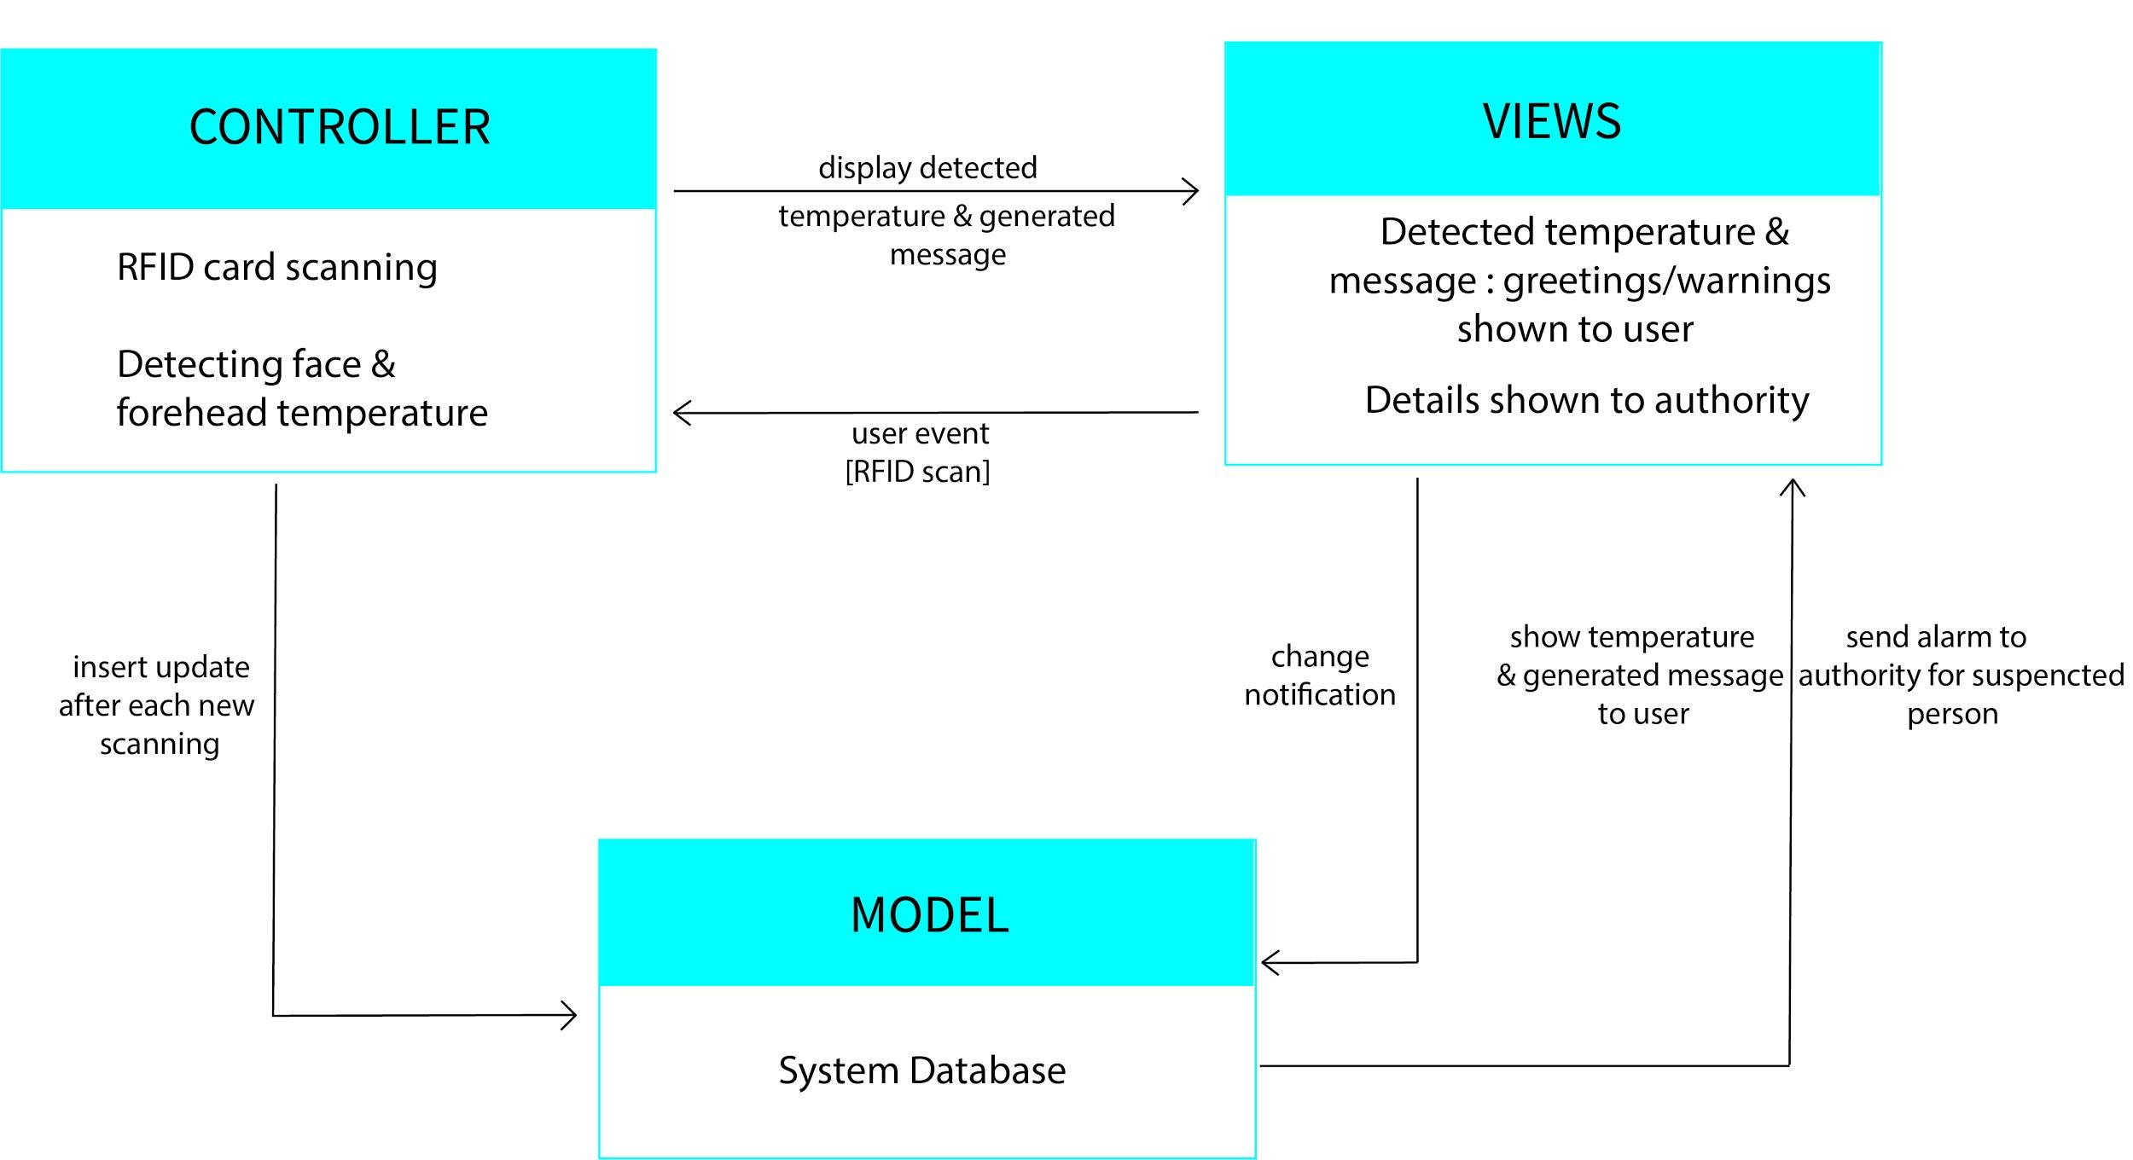
MVC Architecture for Thermique system
Notes:
MVC (Model-View-Controller) architecture approach is followed in system Thermique. MVC pattern is generally used when there are multiple ways to view & interact with data supporting presentation of the same data in several ways & any change, which goes along perfectly with our system. Here, our system is structured in three logical components that’ll interact with one another & these are:
Model Component: The Model Component will manage the system database & associated operations on those data as necessary. So, after each new scan, it’ll enable insert/update of data & show according temperature, message & also send alert notice from the retrieved data.
View Component: This will define & manage how the data will be presented. So, this component will mainly manage displaying detected temperature of the user & generated message to both user & the authority.
Controller Component: This will basically manage user interactions which is RFID card scanning & facial detection of the user for our system, and will pass these interactions to Model & View component.

Slide 12
System Model

Slide 13
System Model
Context Diagram
Use-case Diagram
Activity Diagram
Sequence Diagram

Slide 14
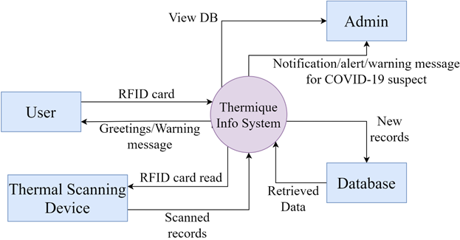
Context Diagram for Thermique System

Slide 15
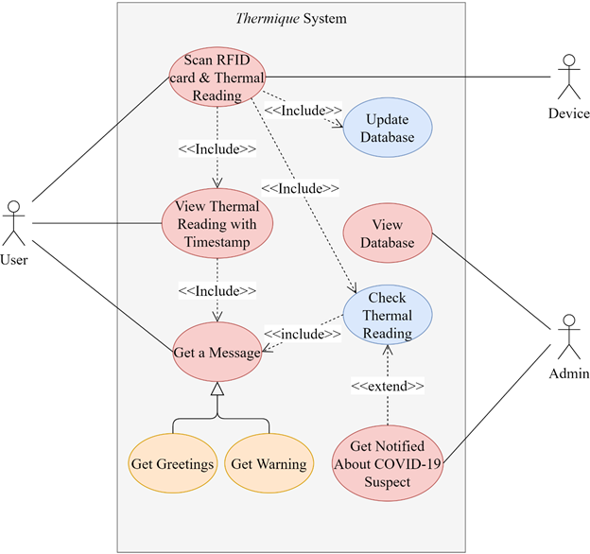
Use-case Diagram for Thermique System
Tabular representation of Use-case diagram
Primary Actors | User
Secondary Actors | Admin, Device
Data | RFID card input, Body temperature
Pre-condition | RFID cards distributed
Post-condition | No system failure
Stimulus | Scanning RFID card
Response | Temp. & msg display
Comments | Device has to detect face within camera feed

Slide 16
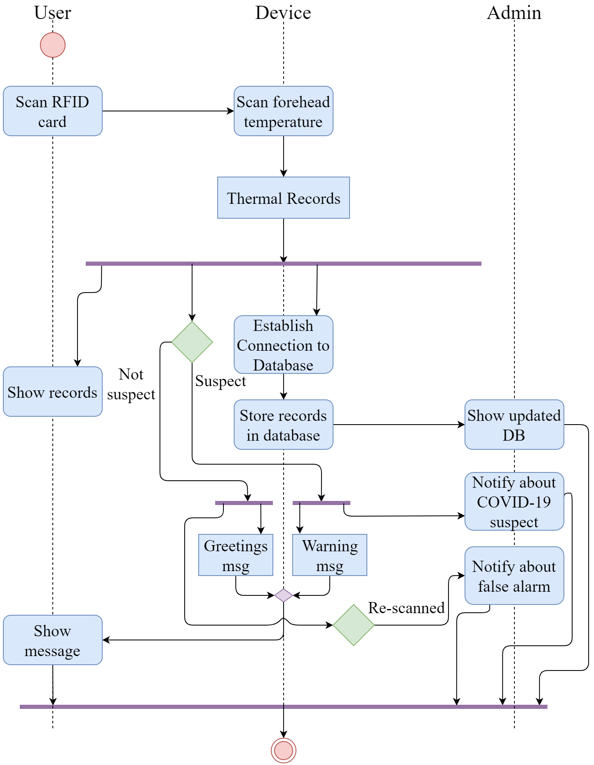
Activity Diagram for Thermique System

Slide 17
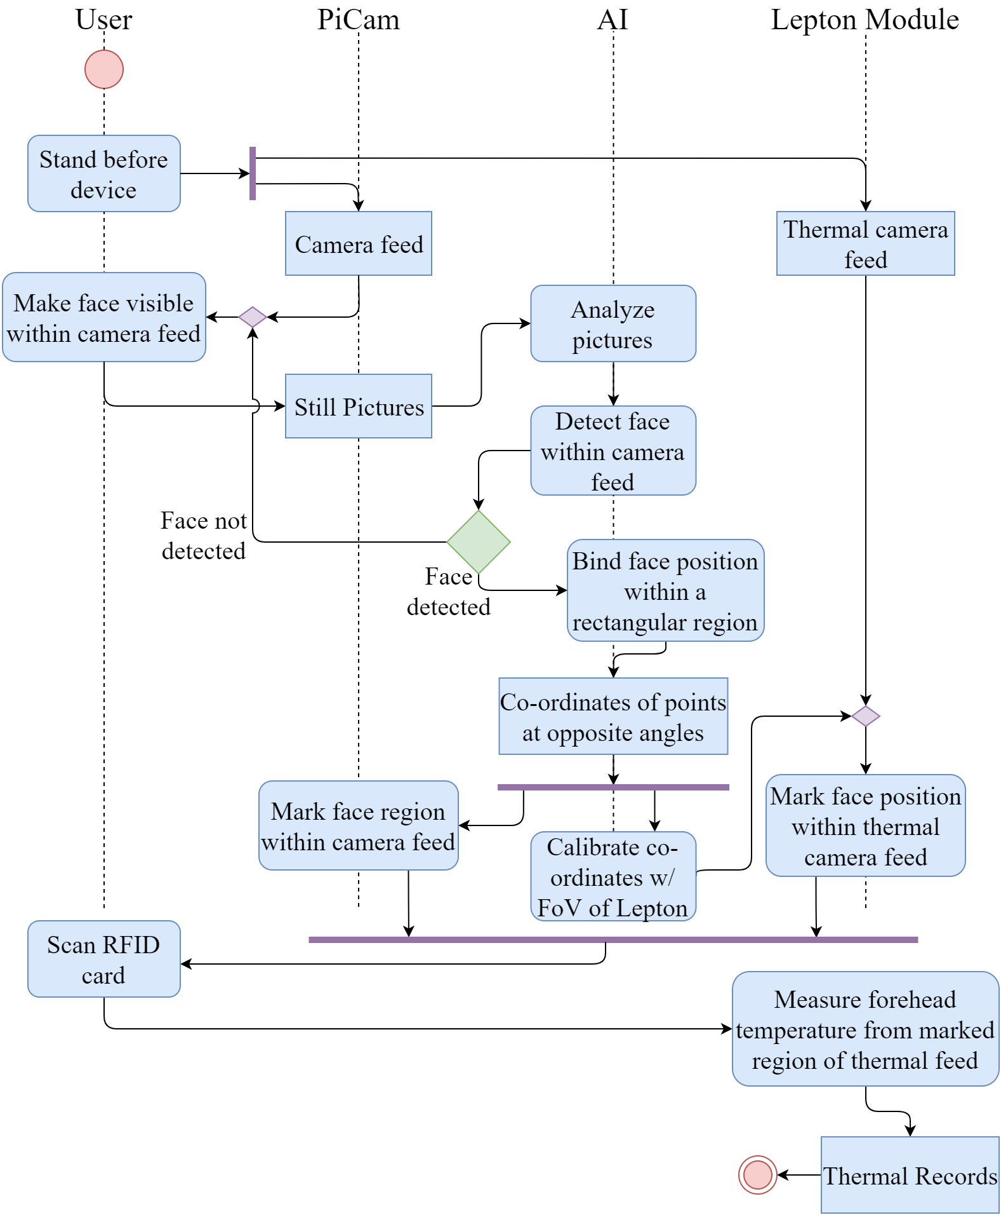
Activity Diagram for Thermique System - AI scenario

Slide 18
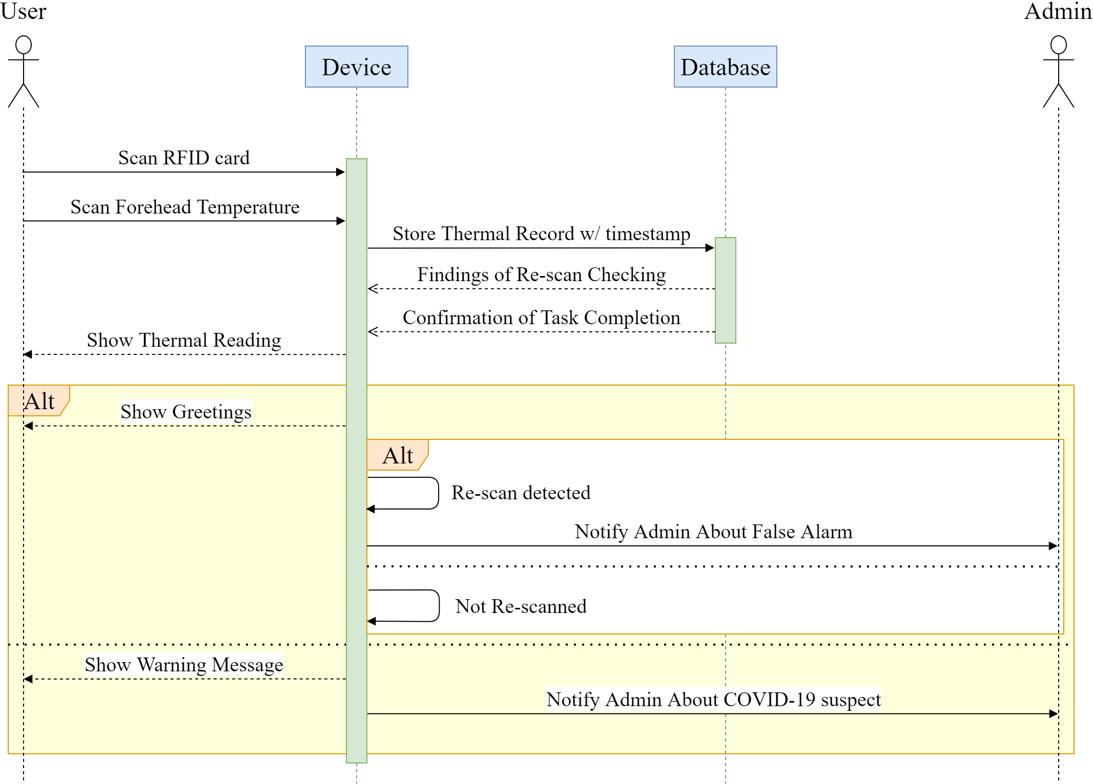
Sequence Diagram for Thermique system

Slide 19
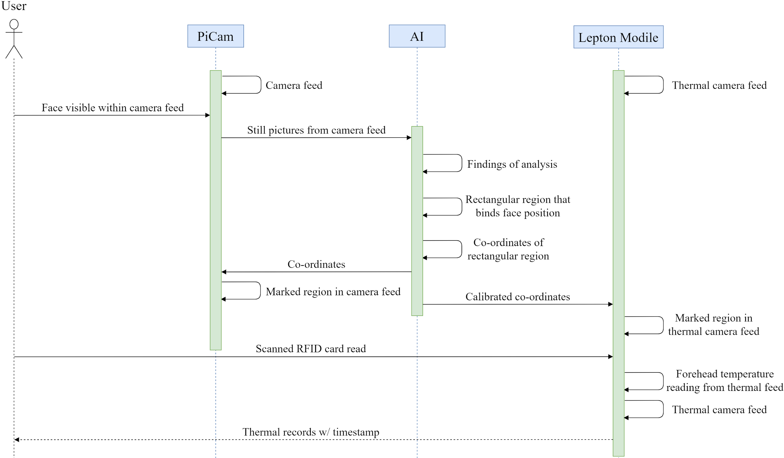
Sequence Diagram for Thermique system - AI scenario

Slide 20
UI Design

Slide 21
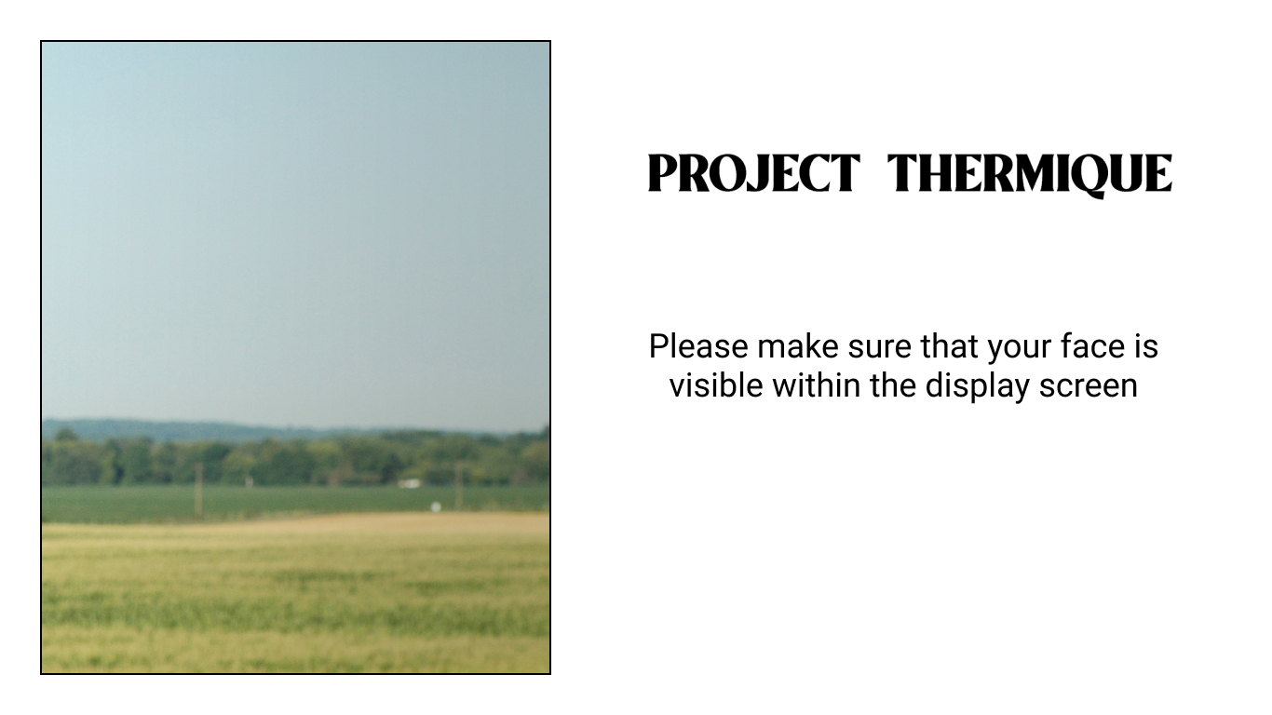

Slide 22
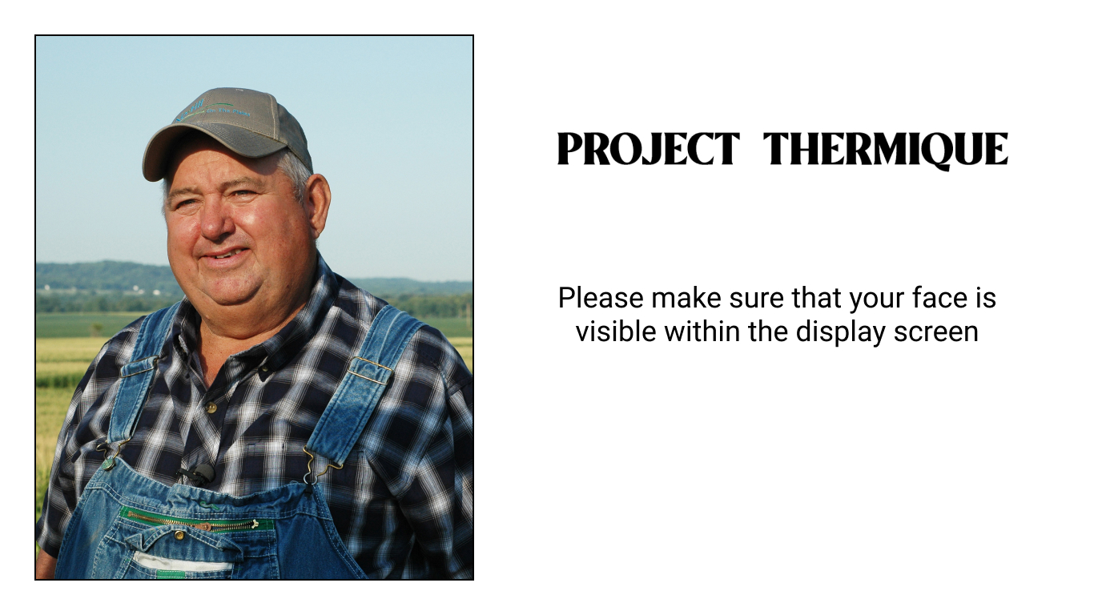

Slide 23
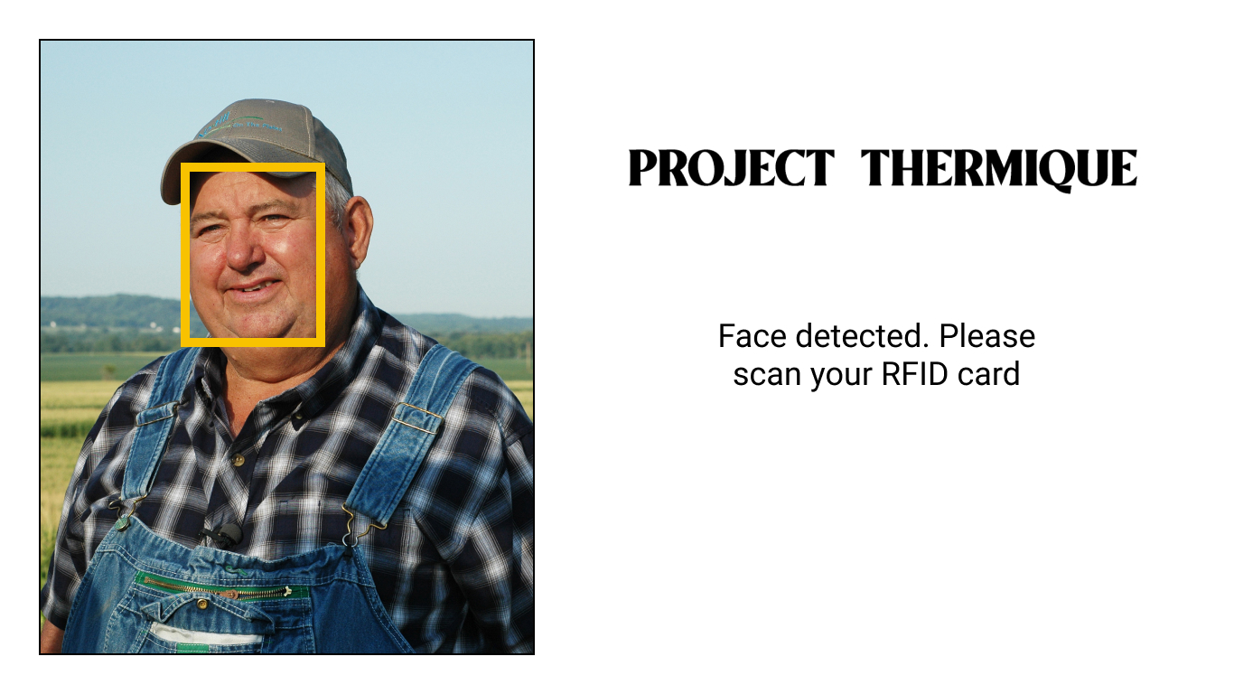

Slide 24
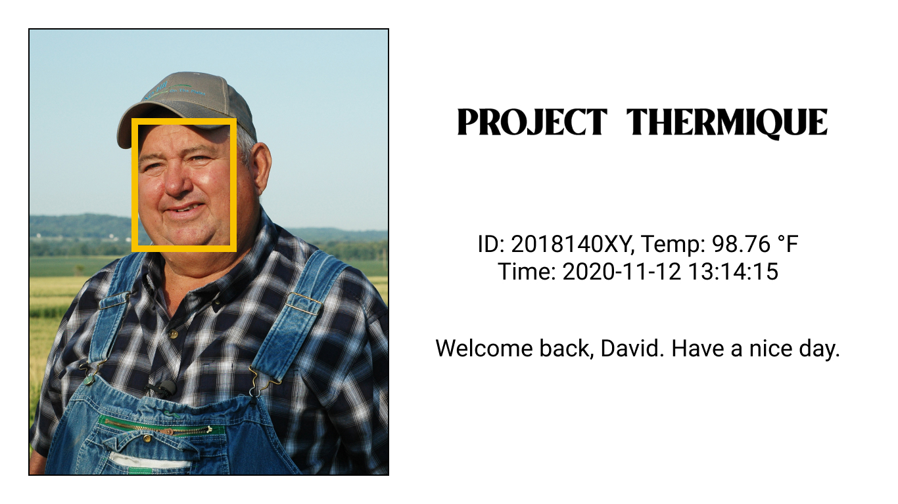

Slide 25
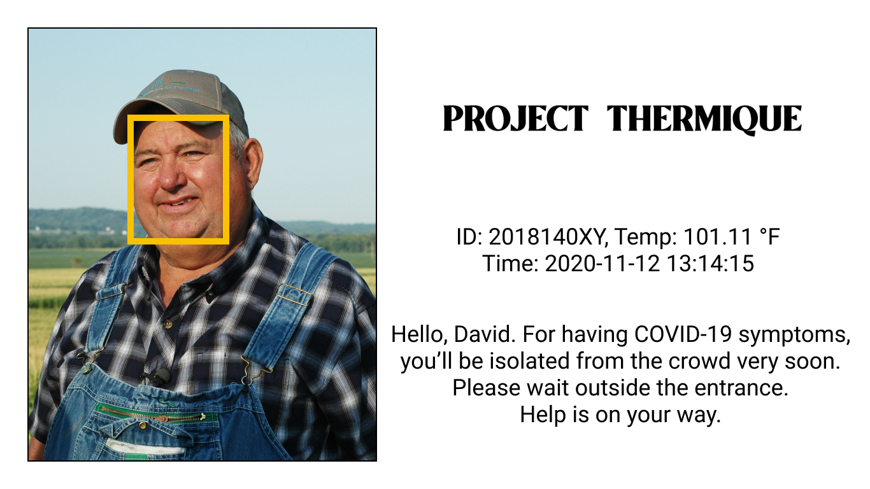

Slide 26
UI Design (contd.)

Slide 27
Future Scopes for project Thermique
Automated hand sanitizer sprayer could be added in our system so that a person standing at a certain distance would be able to use sanitizer without having to press the bottle
Our system could be extended further to incorporate contact tracing feature basing on RFID information of each person.
Face recognition is another possible evolution for our system. Facial recognition could be implemented alongside RFID based scanning so that this could be linked with attendance system & store that in attendance database.
Our system is combined of several hardware devices which might be tough to carry & most importantly, these devices have high sensitivity issues. So, a compact box could be built which would make it easier for any sort of transportation & implementation of the system at any place.

Slide 28


Slide 29
Thank You

